Slide 1
A Fragment Library of Natural Products and Compounds Databases for Drug Discovery
Ana Luisa Chávez-Hernández
National Autonomous University of Mexico
WORKSHOP ON SECONDARY METABOLITE DISCOVERY
Computational Applications in Secondary Metabolite Discovery
9 March 2021

Slide 2
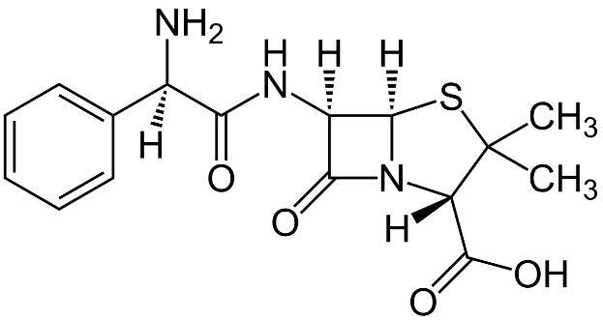
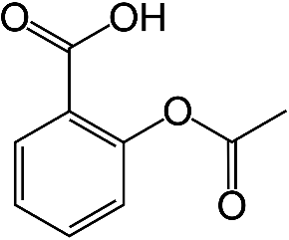
Background
Natural products have been relevant since the beginning of the pharmaceutical era.
1562 Approved drugs for clinical use (1981-2015).
4% Natural products
21 % Derived from natural products
Acetylsalicylic acid
(Aspirin)
Ampicillin
In addition, natural products fragments can be generated with retrosynthetic rules and these substructures can serve as building-blocks in the Pseudo-NP synthesis or de novo design.
Pseudo-NP synthesis combine NP-fragments in a way that has not yet been observed in nature.
Vidadala, S. R.; Golz, C.; Strohmann, C. et. al. Angew. Chem., Int. Ed., 2015, 54, 651–655.
Gao, D.; Zhou, T.; Da, L.-T. et. Al. Org. Lett., 2019, 21, 8577–8581.

Slide 3
Background
Natural products (NP) have unique functional groups.
Few amounts from NP are obtained during extraction and purification procedures.
To maximize the use of NP, we propose to generate fragments libraries from NP that can be used such as building blocks for the synthesis of the so-called “pseudo-NP.”
Dataset | Original compounds | Processed compounds | Generated fragments
COlleCtion of Open NatUral producTs (COCONUT) | 432,706 | 382,248 | 52,630
Food Database (FooDB) | 23,883 | 21,319 | 3186
Dark Chemical Matter (DCM)* | 139,352 | 139,326 | 14,001
Chemical Abstract Service (CAS) set focused on COVID-19 | 48,876 | 44,692 | 8432
Inhibitors of the main protease of SARS-CoV-2 (3CLP) | 280 | 256 | 108
*Compounds that not showed activity although that have been thoroughly tested (DCM)
Sorokina, M.; Steinbeck, C. J Cheminform. 2020, 12, 20.
Chen, Y.; Kirchmair, J. Mol. Inf. 2020, 39, 2000171.
Christoforow, A.; Wilke, J.; Binici, A. et al. Angew. Chemie Int. Ed. 2019, 58, 14715–14723.

Slide 4
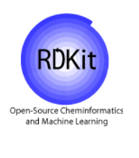
Methods
Data set
Curated SMILES and generation of canonical tautomers
Fragment libraries generated using Retrosynthetic Combinatorial Analysis Procedure (RECAP)
Visualization of chemical space using TMAP for both compounds and fragments
Structural features such as fraction of chiral carbons; fraction of sp³ carbons; atoms of carbon, oxygen, nitrogen
Chávez-Hernández, A.L.; Sánchez-Cruz, N.; Medina-Franco, J.L. Biomolecules. 2020, 10, 1518

Slide 5
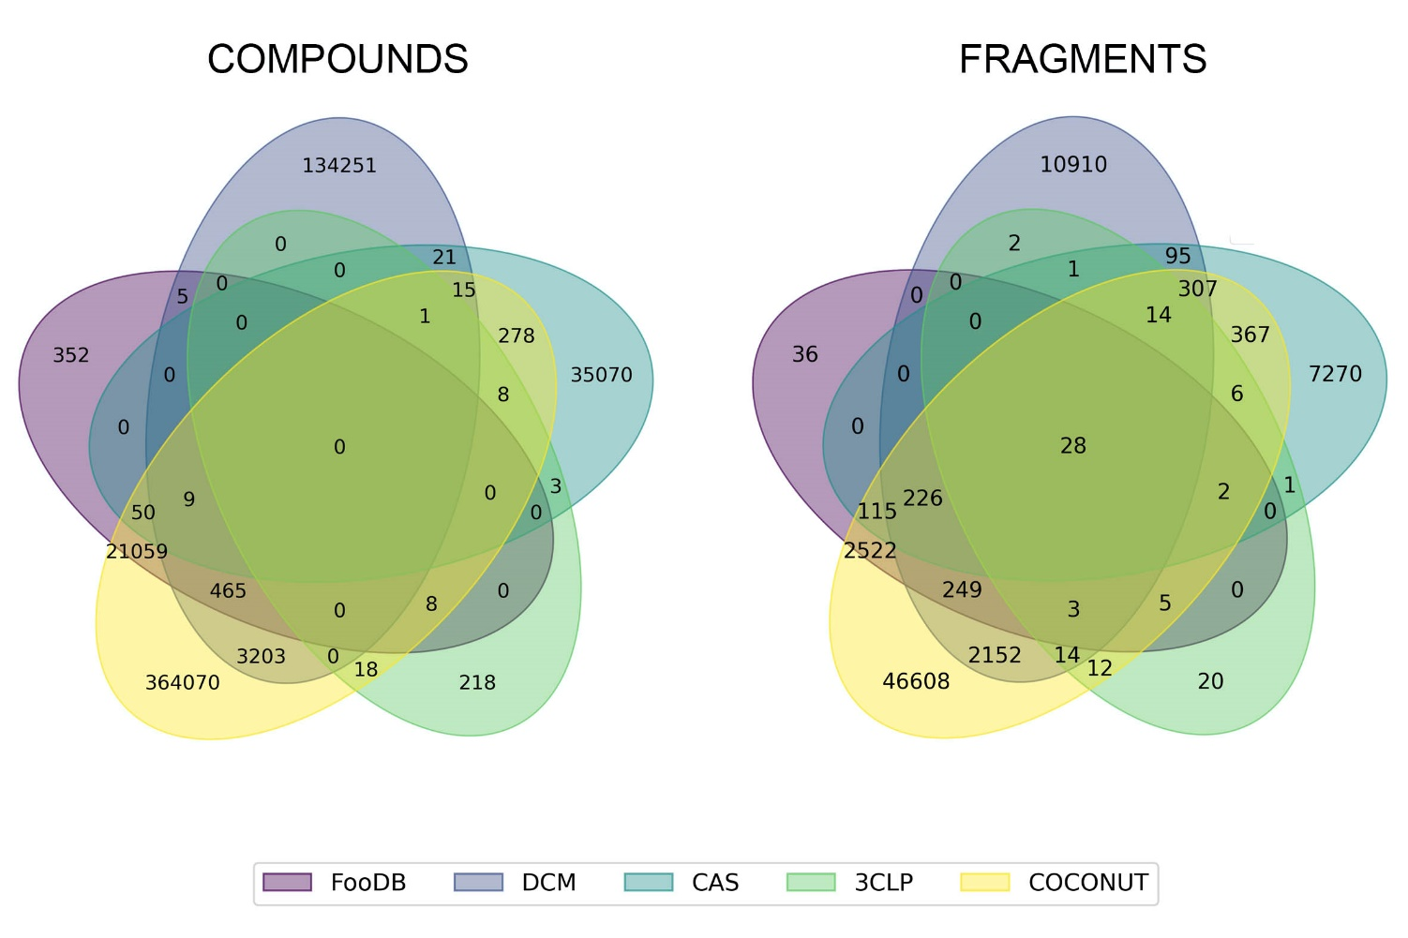
Overlapping structures between COCONUT, FooDB, DCM, CAS, 3CLP
28 overlapping fragments between five data sets.
Chávez-Hernández, A.L.; Sánchez-Cruz, N.; Medina-Franco, J.L. Biomolecules. 2020, 10, 1518

Slide 6
Compounds Structural Features
Natural products (COCONUT, FooDB) had the largest number of carbon and oxygen atoms as well as compounds in the COVID-19 focused set (CAS and 3CLP). This trend was very similar in their derived fragments.
COCONUT-fragments and compounds in the COVID-19 focused set had the largest number of nitrogen atoms.
Natural products (fragments and compounds) had the highest structural complexity (fraction of sp³ carbons and fraction of chiral carbons). Also, compounds in the COVID-19 focused set.
Natural product fragments could be used as building-blocks for synthesis of bioactivity molecules.
Structural features | COCONUT | FooDB | DCM | CAS | 3CLP
Carbon atoms | 25.640 | 26.563 | 18.059 | 22.496 | 25.828
Oxygen atoms | 6.167 | 7.343 | 3.252 | 5.773 | 4.922
Nitrogen atoms | 1.445 | 0.668 | 2.859 | 4.157 | 3.582
Fraction of sp³ carbons | 0.506 | 0.620 | 0.342 | 0.489 | 0.291
Fraction of chiral carbons | 0.154 | 0.152 | 0.028 | 0.145 | 0.069
Fragments-Structural Features
Structural features | COCONUT | FooDB | DCM | CAS | 3CLP
Carbon atoms | 18.504 | 12.991 | 10.181 | 9.904 | 8.926
Oxygen atoms | 3.524 | 3.173 | 1.748 | 3.678 | 1.556
Nitrogen atoms | 0.795 | 0.394 | 1.475 | 0.883 | 0.713
Fraction of sp³ carbons | 0.557 | 0.615 | 0.330 | 0.656 | 0.298
Fraction of chiral carbons | 0.189 | 0.199 | 0.054 | 0.240 | 0.071
Chávez-Hernández, A.L.; Sánchez-Cruz, N.; Medina-Franco, J.L. Biomolecules. 2020, 10, 1518

Slide 7
Visualization of the chemical space of the compounds data sets generated with Tree Maps
TMAP is a method to visualize thousands of compounds. Each set of similar compounds is linked together to form branches which are then linked to each other.
All compounds converge in the chemical space defined mostly by COCONUT, followed by DCM.

Slide 8
Visualization of the chemical space of the compounds data sets generated with Tree Maps
All fragments converge in the chemical space defined mostly by COCONUT, followed by DCM.

Slide 9
Visualization of the chemical space with Tree Maps
Compounds
Fragments
There are more overlapping compounds between COCONUT and FooDB, compared to their fragments.
Chávez-Hernández, A.L.; Sánchez-Cruz, N.; Medina-Franco, J.L. Biomolecules. 2020, 10, 1518

Slide 10
Visualization of the chemical space of the compounds data sets generated with Tree Maps
Compounds
There are more fragments in common between COCONUT-CAS and COCONUT-DCM, compared to their compounds.
Fragments

Slide 11
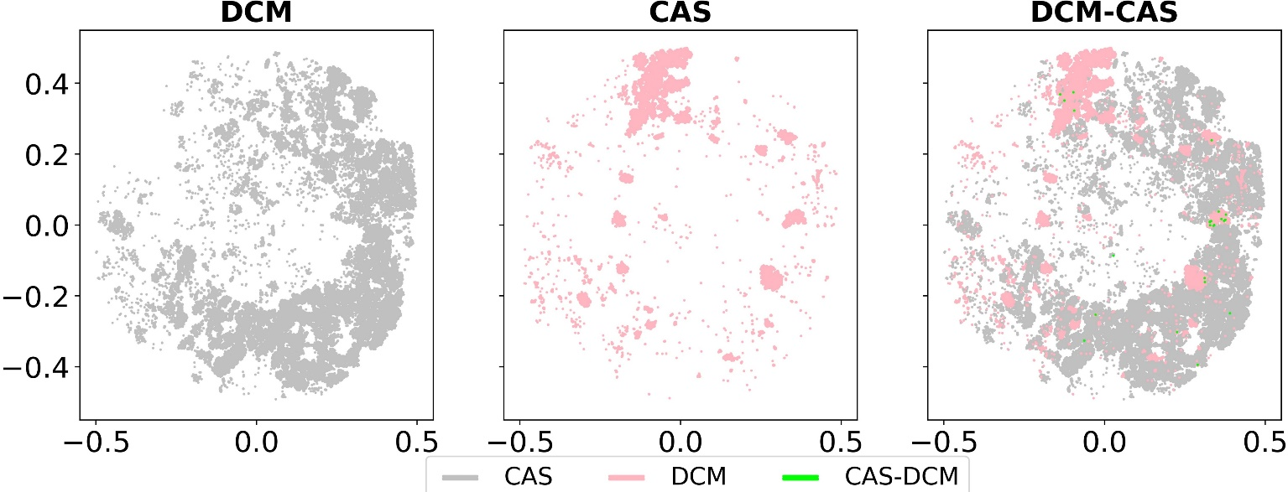
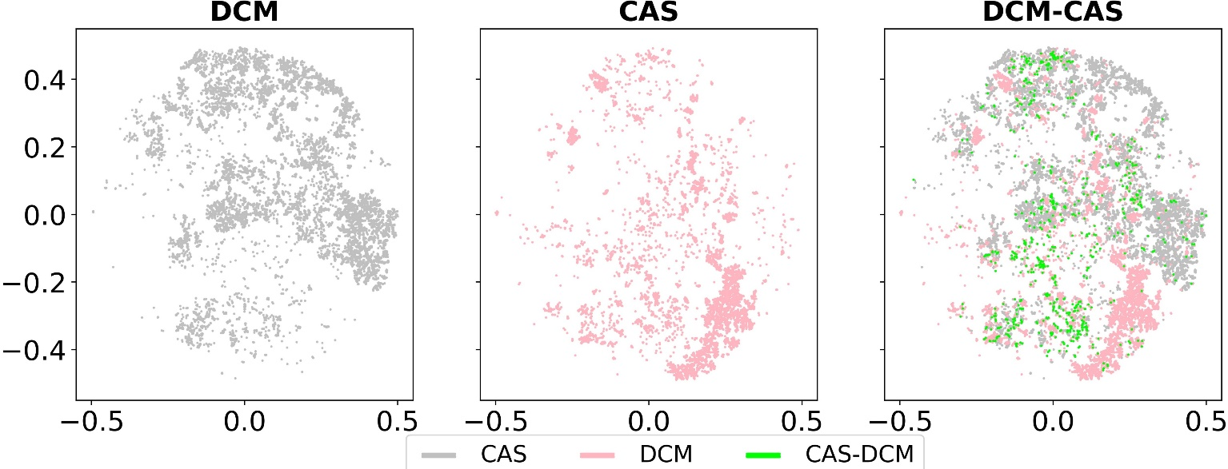
Visualization of the chemicla space of the compounds data sets generated with Tree Maps
Compounds
Hardly, compounds between CAS and DCM converge in chemical space, contrary to their fragments.
DCM fragments, too, can be used as building blocks in the de novo design of bioactive molecules even though the original compounds have weak biological activity.
Fragments

Slide 12
Conclusions
The natural product fragment libraries we generated in this work are public available at: https://doi.org/10.6084/m9.figshare.13064231.v1
Molecular fragments retained the structural characteristics from original compounds which was consistent with the results of our previous work. Natural products (COCONUT and FooDB) were structurally more complex as well as compounds in a COVID-19 focused set (CAS). Therefore, they would be a an important starting point for the synthesis of new novel and bioactive molecules (de novo design).
The chemical space defined by the structural diversity of each data set is mostly defined by NP (COCONUT) followed by DCM: for compounds and fragments.
DCM-fragments can be used as building-blocks in de novo design of bioactive molecules even though the parent compounds have weak biological activity.

Slide 13
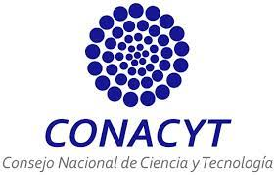
Acknowledgements
José L. Medina-Franco, PhD for accepting me into your research group (DIFACQUIM). PhD Supervisor.
Norberto Sánchez-Cruz, PhD for his help with python and sharing his experience and knowledge in cheminformatics.
Maria Sorokina, PhD for developing COlleCtion of Open NatUral producTs (COCONUT) and making it public-available.
Scholarship 847870
Project LANCAD-UNAM-DGTIC-335

